Slide 1
Chapter 4: Directional & Horizontal Drilling
Well Trajectory Design

Slide 2
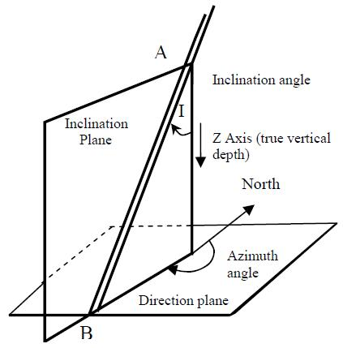
Basic Concepts

Slide 3
Basic Concepts
The distance from rotary table to Point B as measured along the wellbore is called a measured depth.
The vertical distance from rotary table to Point B is called a true vertical depth
The inclination angle ‘I’ is the angle between vertical and the wellbore.
The direction angle ‘A’ is specified as the azimuth between the geographic north and the projection of a wellbore on a horizontal plane.

Slide 4
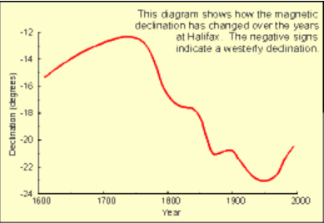
Basic Concepts
Azimuth
Complex fluid motion in the outer core causes the earth.’s magnetic field to change slowly and unpredictably with time (secular variation)
.• The position of the magnetic poles also change with time .
• However, we are able to compensate for this variability by applying a correction (declination) to a magnetic survey which references it to true north

Slide 5
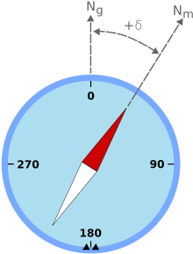
Basic Concepts
Azimuth
The angle between geographic (true) and magnetic north (MN) is called the declination angle. A location where the measurements are taken is called a station. At each station, a measured depth, hole angle, and azimuth are recorded.
Example of magnetic declination showing a compass needle with a "positive“ variation from geographic north.

Slide 6
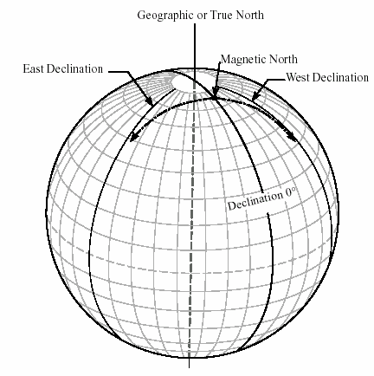
Basic Concepts
Azimuth
• True north, or geographic north, is aligned with the spin axis of the Earth
• True north does not move making it a perfect reference
• A survey referenced to true north will be valid today and at any time in the future
• The correction we apply to change a magnetic north direction to a true northdirection is called declination.
Geographic or True North
Magnetic North
East Declination
West Declination

Slide 7
Basic Concepts
Azimuth
Applying Declination
• To convert from Magnetic North to True North, Declination must be added:
True Direction = Magnetic Direction + Declination
Important Note:
• East Declination is Positive & West Declination is Negative in both the northern and southern hemispheres

Slide 8
Basic Concepts
Azimuth
Typically, the measurements are taken at intervals between 30 - 300 ft and even shorter depending on the complexity of well path and the purpose of well bore.
It is a conventional practice to use a 90 deg. quadrant , North, East, South and West (NE-S-W) to report well direction. For example, the azimuth angles A₁ = 27 deg and A₂ = 215deg can also be reported as A₁ = N27E and A₂ = S35W In other words, if the hole direction is reported as E26S the azimuth is 116 deg.
Declination angle is the angle between geographic (true) and magnetic north (MN).

Slide 9
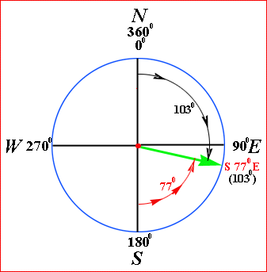
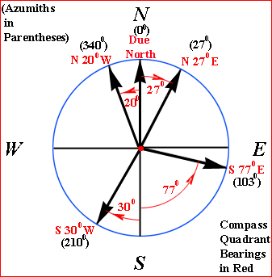
Basic Concepts
Azimuth

Slide 10
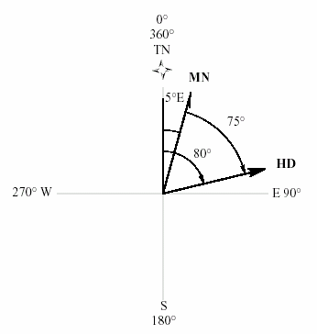
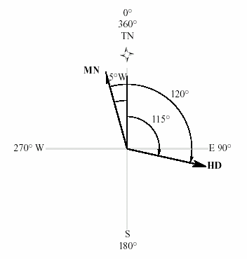
Basic Concepts
Azimuth
N75E
S60E
A = Magnetic Direction + Declination
A = 75° + (+5°) = 80°
A = Magnetic Direction + Declination
A = 120° + (-5°) = 115°

Slide 11
Basic Concepts
Azimuth
TN
TN
5E
5W
HD
N45W
W
E
W
E
A = 215º
A = 220º
S30W
HD
S
S
A = Magnetic Direction + Declination
A = 210° + (+5°) = 210°
A = Magnetic Direction + Declination
A = 225° + (-5°) = 220°

Slide 12
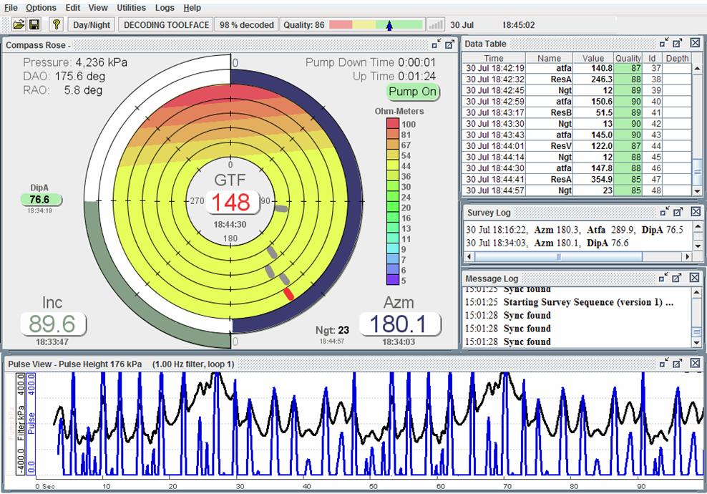
Well Trajectory Design
Basic Concepts

Slide 13
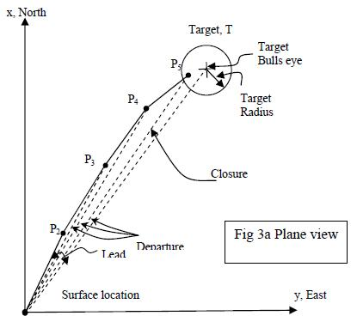
Basic Concepts
Lead Angle
The lead angle is to modify the direction of the target. The lead angle is usually to the left of the target horizontal departure line. The magnitude and direction (left or right) are based on the analysis of forces at the drill bit and local field experience.
Drillpipe rotation results in right hand bit walk and therefore a left lead angle is used to compensate for this tendency.

Slide 14
Basic Concepts
KOP – Build Rate – Turn Rate
Kick-off point (KOP) is the depth where the well trajectory departs from the vertical in the direction of the target or modified by the lead angle.
The build-rate angle and drop-rate angle, respectively, refer to the incremental increase or decrease in inclination from vertical
The turn-rate angle is the change in azimuth per 100 feet or meters of hole section.

Slide 15
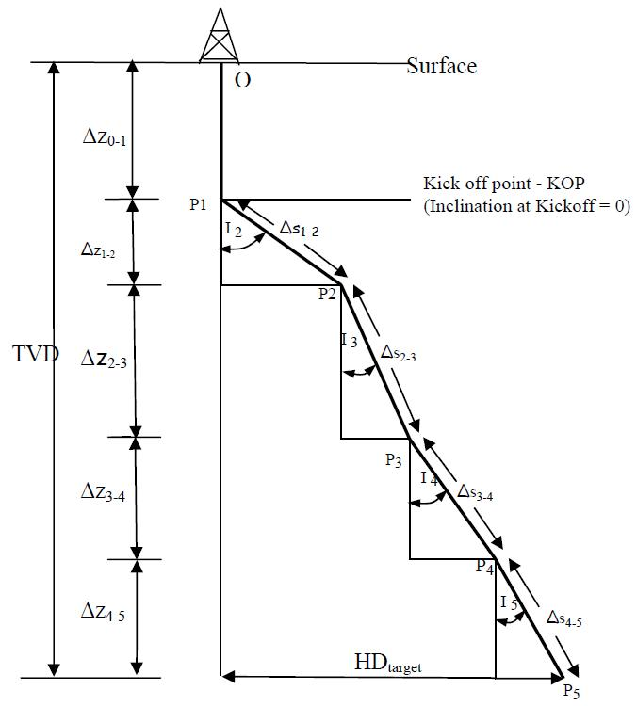
Basic Concepts

Slide 16
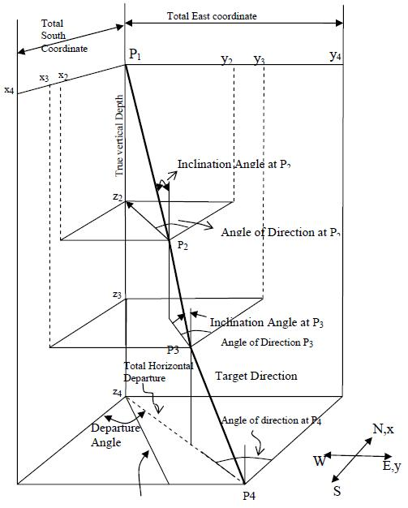
Basic Concepts

Slide 17
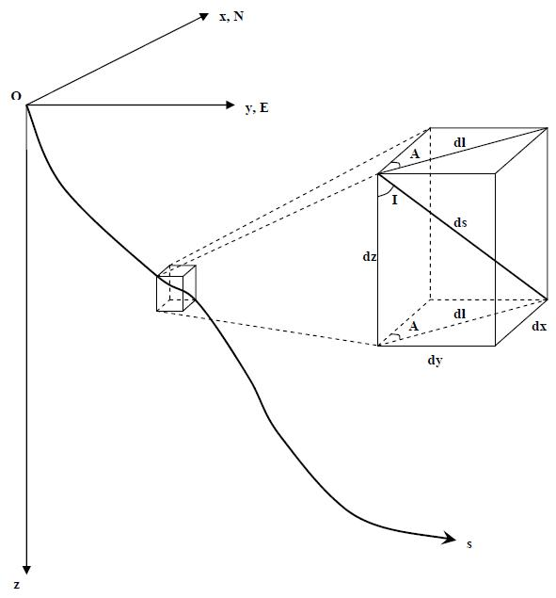
Fundamental Mathematical Formulations

Slide 18
Fundamental Mathematical Formulations
The continuous curve O-s represents the well trajectory (wellbore center line). Let us consider a small element ‘ds’ with the components of dx, dy and dz. Since the element ‘ds’ is small we can approximate it as a straight segment with the inclination angle I and azimuth A. The projection of the small element ‘ds’ on a horizontal plane we denote as ‘dl’. As we move along the well path, in general, both inclination angle and azimuth will change. In other words, hole inclination angle and azimuth are functions of measured depth‘s’.

Slide 19



Fundamental Mathematical Formulations
Definitions
Build rate: rate of change of hole inclination angle along the well path
Hrizontal turn rate: rate of change of azimuth angle along the projection of well path on a horizontal plane
Turn rate: rate of change of azimuth along the well path
(1)
(2)
(3)

Slide 20
Fundamental Mathematical Formulations
Definitions
In directional drilling the build and turn rates are usually expressed in deg/100ft (deg/30m) and care should be exercised when calculations are carried out in a consistent system of units (radians rather than degrees).
The rate of change can be positive or negative depending whether the angles increase or decrease with the measured depth.
For example, the negative build rate indicates that the inclination angle decreases with depth and then it is usually called a drop rate.

Slide 21
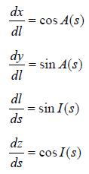
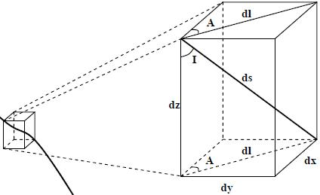
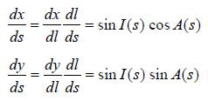
Fundamental Mathematical Formulations
(4)
(5)
(6)
(7)
(8)
(9)

Slide 22
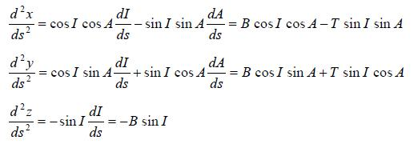
Fundamental Mathematical Formulations
(10)
(11)
(12)

Slide 23
Fundamental Mathematical Formulations
The task of the designer is to calculate the coordinates, of all other points on the well path.
This is usually accomplished in a stepwise manner by selecting the subsequent point on the trajectory a distance Δs (measured along the trajectory) from the initial point (e.g. KOP).
To carry out the required calculations assumptions must frequently be made about well path build and turn rates as well hole inclination and directions angles.
Calculations are repeated until a smooth well path is obtained that will reach the target / targets.

Slide 24
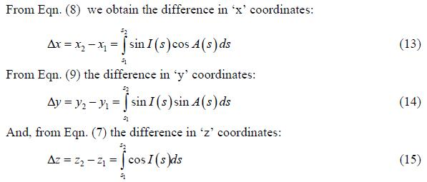
Fundamental Mathematical Formulations
Basic Equations

Slide 25
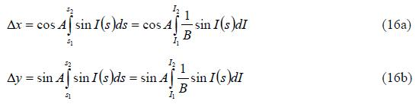

Fundamental Mathematical Formulations
2-D Assumption
If a well path is confined to a vertical plane its azimuth ‘A” is constant along the trajectory. Then, Eqn. (13), Eqn. (14) and Eqn. (15) take forms:

Slide 26
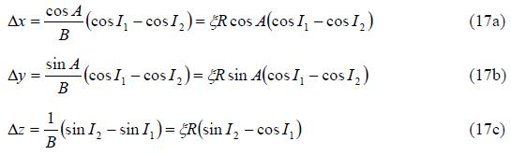
Fundamental Mathematical Formulations
2-D and R Constant Assumptions
If a wellbore segment is a circular arc with the radius R, the build rate is constant and equal to 1/R. Then, Eqns. (16) can be integrated and take forms as below:
The parameter ξ = +1 for positive turn rate and ξ = -1 for negative rate. R = 1/B
The horizontal departure HD between point 1 and point 2 is
ξR(sinI₂ – sinI₁)

Slide 27
Fundamental Mathematical Formulations
2-D and R Constant Assumptions
Example 1: Consider two points on a curved part of a trajectory located in a vertical plane with the azimuth A = 60deg. The hole inclination angle at Point 1 is I₁ = 65deg. And point 2 is I₂ = 32deg. The drop off rate is 6.5deg/100 ft. (B = −6.5 deg 100 ft). The rectangular coordinates of Point 1 are x₁ = 1650 ft., y₁ = 2858 ft. and z₁ = 4250 . Calculate
a - x, y, z coordinates at Point 2
b - Radius of curvature R
c - Horizontal departure between Point 1 and Point 2
d - Length of the segment Δs

Slide 28
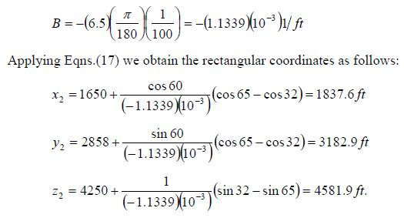
Fundamental Mathematical Formulations
2-D and R Constant Assumptions

Slide 29
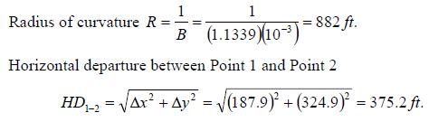

Fundamental Mathematical Formulations
2-D and R Constant Assumptions

Slide 30

Wellbore Curvature and Dogleg Severity
In directional drilling nomenclature the wellbore curvature is frequently named as a dogleg severity (DLS) and expressed in deg/100ft as mentioned earlier. We know from the course on calculus that the curvature of a 3D curve can be calculated as follows:
Eqn (20) gives curvature in any consistent system of units e,g. 1/ft , 1/m.
Students, derive this equation!!!

Slide 31

Wellbore Curvature and Dogleg Severity
In practical directional drilling terminology we frequently use the term the dogleg severity rather than curvature and express it in degrees per unit length. If the dogleg severity is expressed in deg/100ft we write:
Note: the unit of curvature K is 1/ft. And 180 degrees equivalent to π in radian. There for the unit of DLS calculated as equation (21) is degrees/100ft.
The radius of curvature R is defined as the inverse of curvature and we write:

Slide 32
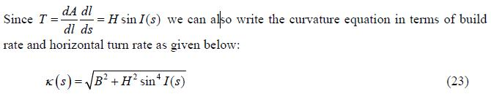
Wellbore Curvature and Dogleg Severity
Substituting Eqn. (10), Eqn. (11) and Eqn. (12) to Eqn. (20), after some rearrangements, we obtain the wellbore curvature in terms of build rate, turn rate and hole inclination angle as follows.

Slide 33





Wellbore Curvature and Dogleg Severity
The overall angle change (dogleg) between two points on wellpath is defined as the angle between the tangent lines at the two points under considerations. The curvature is the rate of over all angle change along the trajectory; therefore, the overall angle change "β " between two neighboring points on the trajectory located Δs apart is obtained by integrating curvature along the trajectory as follows:
Note that: and
If there is no change in azimuth along the well path, the dogleg (DL) would be:

Slide 34

Wellbore Curvature and Dogleg Severity
Lubinski ( 1953 ) was the first to derive the equation for dogleg in a form:
Analysis of Eqn. (26) shows that for A₁ = A₂ Eqn (26) is reduced to Eqn. (25)

Slide 35
Design of Two Dimensional Well Profiles
Directional Wells
Typically the design of a directional well profile consists of two phases:
1. Firstly a wellpath is constructed to connect target with the surface location and then adjustments are made to account for factors that will eventually influence the final trajectory.
2. After the base well trajectory is calculated the designer needs to make corrections to compensate for the anticipated effects related to drill pipe rotation (bit walk), formation hardness and dip angle, type of drillbits etc.

Slide 36
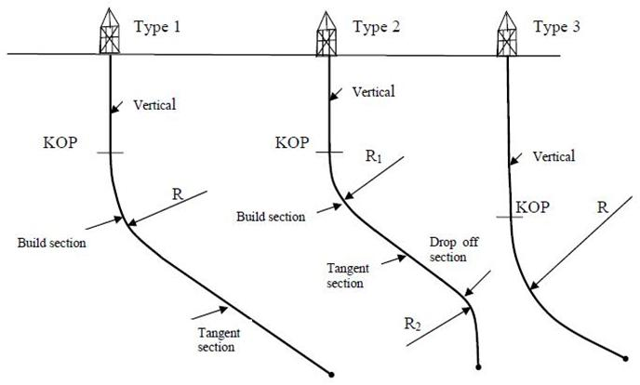
Design of Two Dimensional Well Profiles
Directional Wells

Slide 37

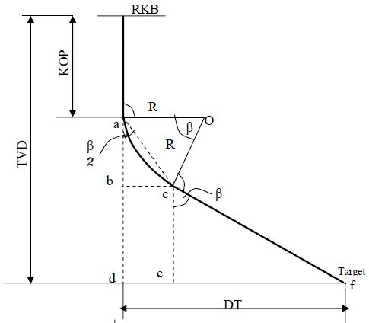
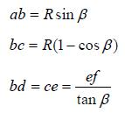

Design of Two Dimensional Well Profiles
Directional Wells
Type 1: Build and hold (Slant type)
= HD
β = I₂ – I₁ = I₂
= HD

Slide 38




Design of Two Dimensional Well Profiles
Directional Wells

Slide 39


Design of Two Dimensional Well Profiles
Directional Wells
Combining these equations give
If target total vertical depth TVD, kick off point depth KOP, horizontal departure DT and radius of build section are given then Eqn (27) can be solved for the dogleg angle β :
(27)

Slide 40
Design of Two Dimensional Well Profiles
Directional Wells
Example 2
Design trajectory of a slant type offshore well for the conditions as stated below:
- elevation (above sea level) = 780 ft. - target depth (sub-sea) = -5374 ft. - target south coordinate = 2147 ft. - target east coordinate = 3226 ft. - declination = 6° E - KOP depth = 1510 ft. - build-up rate = 2 deg/100 ft. | It is required to find: slant angle vertical depth at the beginning of tangent part departure at the beginning of tangent part measured depth to the target

Slide 41
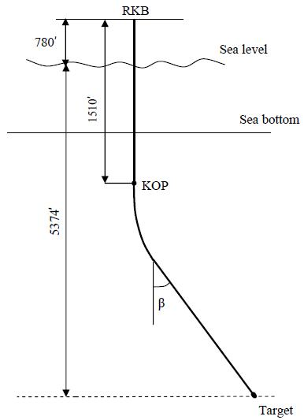
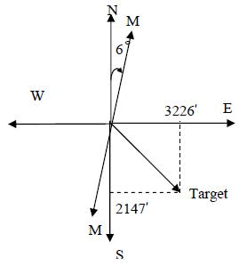
Design of Two Dimensional Well Profiles
Directional Wells

Slide 42
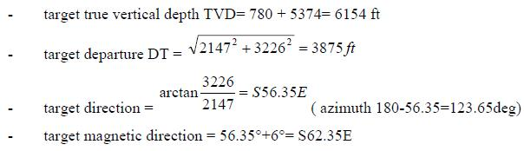
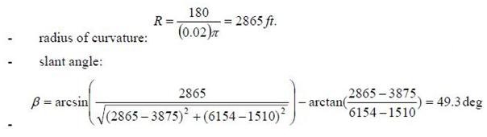
Design of Two Dimensional Well Profiles
Directional Wells

Slide 43
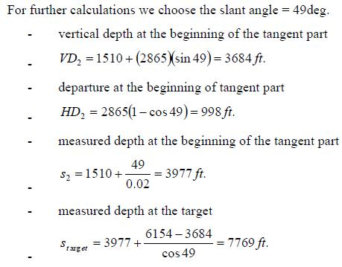
Design of Two Dimensional Well Profiles
Directional Wells

Slide 44
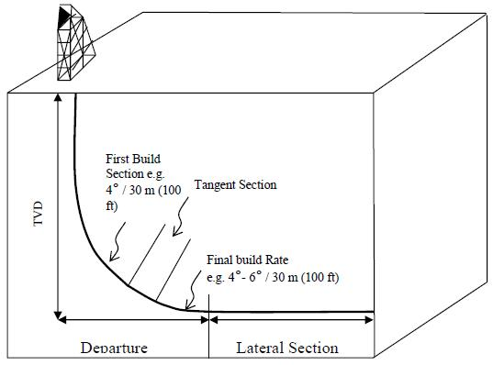
Design of Two Dimensional Well Profiles
Horizontal Wells
In practical applications, horizontal wells are high angle wells with the inclination angle in the range of about 80 deg to 100 deg. An ideal horizontal well, as the name indicates, the inclination angle is equal to 90 deg.

Slide 45
Design of Two Dimensional Well Profiles
Horizontal Wells
Typically, horizontal wells are classified by their radius of curvature as follows:
- long radius with the radius R = 1000 - 3000 ft (DLS = 6 – 2 deg/100ft)
medium radius with the radius R = 200 - 1000 ft (DLS = 30 – 6 deg/100ft)
short radius with the radius R = 30 - 200 ft (DLS = 180 – 30 deg/100ft)
There are also ultra short radius systems that apply high pressure jetting techniques for turning the well from vertical to horizontal.

Slide 46
Design of Two Dimensional Well Profiles
Horizontal Wells
It is desired to design the simple tangent horizontal well profile given:
KOP = 8206 ft.
TVD = 9000 ft.
Tangent length = 120 ft
Tangent angle = 50 deg
Target angle = 90 deg. at TVD
The expected build rate is 8 deg/100 ft.

Slide 47
Design of Two Dimensional Well Profiles
Horizontal Wells
β₁
β₁
β₂
g
β₁
90^{ο}
β₁

Slide 48
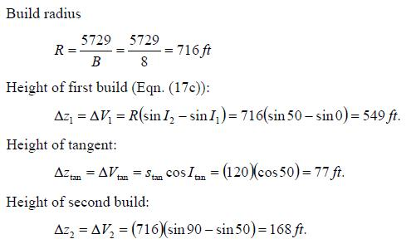
Design of Two Dimensional Well Profiles
Horizontal Wells
(Eq. (21))
Δz₁ = ab = Rsinβ = 716xsin50 = 549 ft
ab
bd
Do not use this equation: Δz₂ = ab = Rsinβ
dg

Slide 49
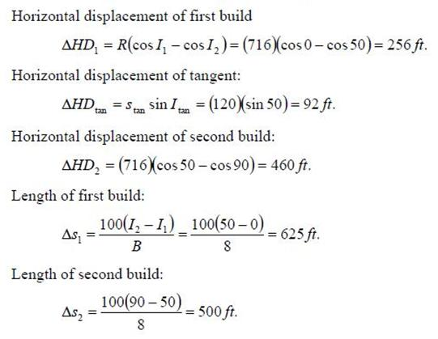
Design of Two Dimensional Well Profiles
Horizontal Wells
(Eq. (18))
Or bc = R(1 – cosβ)

Slide 50
Design of Two Dimensional Well Profiles
Horizontal Wells
Measured depths:
At end of first build: 8206 + 625 = 8831ft.
At end of tangent: 8831 + 120 = 8951 ft.
At end of second build: 8951 + 500 = 9451 ft.

Slide 51
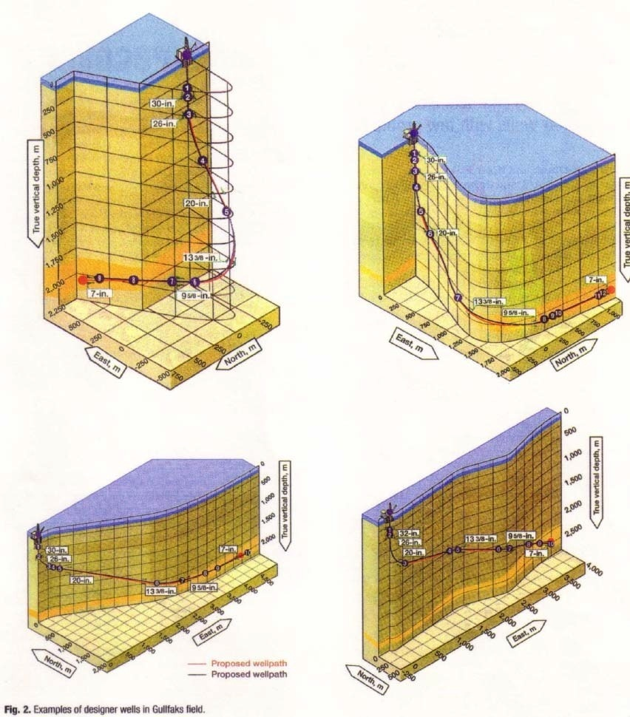
Design of Three Dimensional Well Profiles
Introduction
In engineering practice any well trajectory that is not located in a vertical plane is considered as a 3D well.

Slide 52
Design of Three Dimensional Well Profiles
Introduction
In general, the design task is to construct a 3D smooth path that connects the surface or subsurface location to a know target or targets.
In addition to 3D geometrical requirements the designer must also consider other factors related to the drilling process such as drill string mechanical integrity, wellbore stability, cuttings transport, running casing, cementing and perforating operations etc.
For the purpose of the well-path optimization we usually use minimum cost of drilling or minimum drilling time as the optimization criteria.

Slide 53
Design of Three Dimensional Well Profiles
Introduction
Here we will focus on just the 3D geometrical considerations and discussion of seven methods that are available from SPE literature:
Average Angle Method
Tangential Method.
Balanced Tangential Method.
Radius of Curvature.
Constant Build and Turn Rate.
Constant Curvature and Build Rate (Constant Tool Face).
Minimum Curvature

Slide 54
Design of Three Dimensional Well Profiles
The Average Angle Method
One of the earlier methods is the so called Average Angle Method (AAM). In this approach the well is modeled as a series of straight segments in a vertical and horizontal plane. It is assumed that the inclination and azimuth angles are constant and equal to the average value of two subsequent points on the trajectory. With this assumption, Eqn.(13), Eqn(14) and Eqn(15) are written as below:

Slide 55
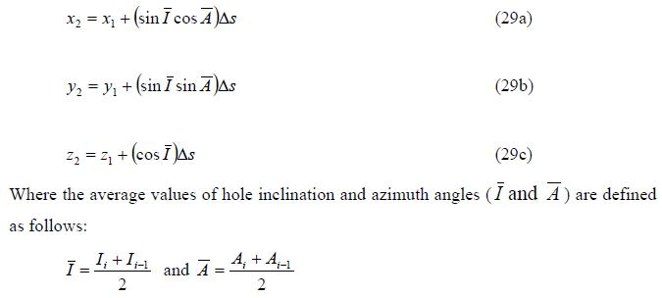
Design of Three Dimensional Well Profiles
The Average Angle Method

Slide 56
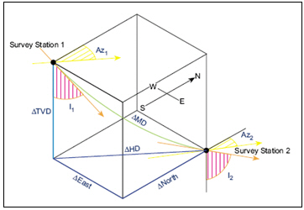
Design of Three Dimensional Well Profiles
The Average Angle Method

Slide 57
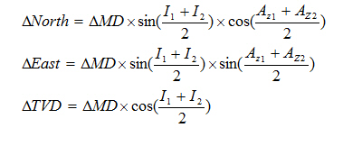
Design of Three Dimensional Well Profiles
The Average Angle Method

Slide 58
Design of Three Dimensional Well Profiles
The Average Angle Method
Example 4
It is required to calculate the rectangular coordinates of the well from the depth of 8000 ft. to 8400 ft. The kick off point is at 8000 ft. and the rate of build is 1 deg/100ft., using a lead of 10 deg. and a right-hand walk rate of 1 deg/100ft. (turn rate in a horizontal plane). Direction of the target is N30E. Assume the first 200ft. is to set the lead, where the direction is held constant to 8200 ft. and then turns right at a rate of 1 deg/100ft.

Slide 59
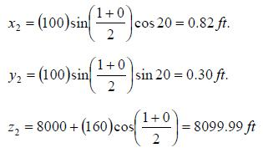
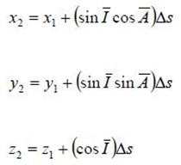
Design of Three Dimensional Well Profiles
The Average Angle Method
The origin of the coordinates is set at the top of the hole ( x₀ = 0, y₀ = 0, z₀ = 0) and the first segment is vertical, hence the inclination angle I₁ = 0 deg. and the azimuth is undetermined. The coordinates of kick off point are: x₁ = 0 ft, y₁ = 0 ft and z₁ = 8600 ft. For the point located at Δs = 100 ft. from the kick off point we calculate: Note A₂ = 30 – lead angle = 30 – 10 = 20º.

Slide 60
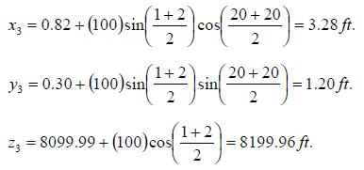
Design of Three Dimensional Well Profiles
The Average Angle Method
From the depth of 8100 ft. to 8200 ft. the inclination angle is increased to 2 deg. And azimuth is N20E.

Slide 61
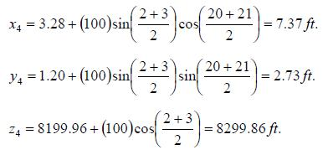
Design of Three Dimensional Well Profiles
The Average Angle Method
From 8200 ft to 8300 ft the inclination angle is increased to 3 deg. and azimuth to N21E hence we calculate:

Slide 62

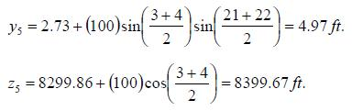
Design of Three Dimensional Well Profiles
The Average Angle Method
From 8300 ft. to 8400 ft. the inclination and azimuth angles increase to 4 deg. and N22E and we get:

Slide 63
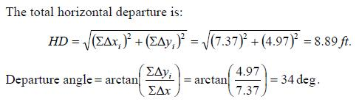
Design of Three Dimensional Well Profiles
The Average Angle Method
(13.05)²
13.96 ft
20.8 deg
13.05

Slide 64



Design of Three Dimensional Well Profiles
Tangential Method
This method treats the inclination angles and azimuths constant and equal to the inclination angles and azimuths at point 2.

Slide 65
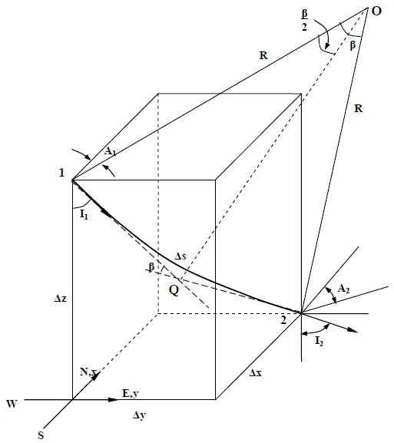
Design of Three Dimensional Well Profiles
Balanced Tangential Method
I₁
A₁

Slide 66
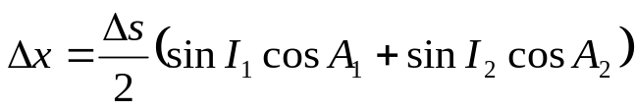
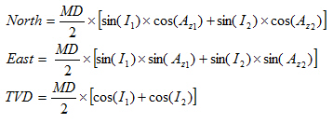

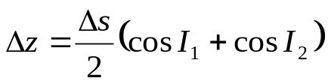
Design of Three Dimensional Well Profiles
Balanced Tangential Method
This method assumes that the actual wellpath can be approximated by two straight line segments of equal length.

Slide 67
Design of Three Dimensional Well Profiles
Balanced Tangential Method
Survey 1
Depth = 3500 ft
Inclination = 15 degree (I₁)
Azimuth = 20degree (A₁)
Survey 2
Depth = 3600 ft
Inclination = 25 degree (I₂)
Azimuth = 45 degree (A₂)
Using balanced tangential method to calculate the Δx, Δy, and Δz.

Slide 68
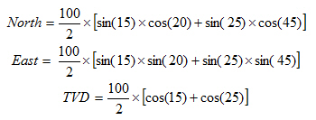
Design of Three Dimensional Well Profiles
Balanced Tangential Method
MD = 3600 – 3500 = 100 ft
North = 27.1 ft
East = 19.37 ft
TVD = 93.61 ft

Slide 69
Design of Three Dimensional Well Profiles
Radius of Curvature Method
The Radius of Curvature Method (RCM) was originally proposed by Wilson (1968) to replace earlier methods that used a series of straight line segments representing wellbore between surveying stations.
In this method it is assumed that the build rate B and horizontal turn rate H are constant on the trajectory.
This is the most famous method for directional survey calculation.

Slide 70
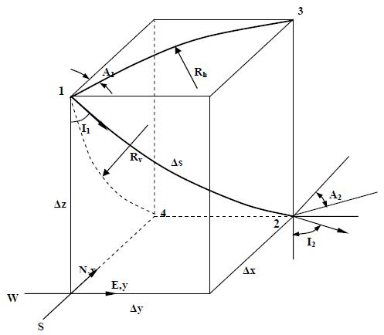
Design of Three Dimensional Well Profiles
Radius of Curvature Method
B and H are constant imply that the projections on the vertical and horizontal plane have constant curvature.
R_{v} = 1/B
R_{h} = 1/H

Slide 71
Design of Three Dimensional Well Profiles
Radius of Curvature Method
It should be pointed out that even if build and turn rates are constant the wellbore curvature is not constant between the two points on the well path since the hole inclination angle varies between Point 1 and Point 2.
With the assumption that both built and turn rates are constant (B=const and H=const) by integration of Eqn. (13) , Eqn. (14) and Eqn. (15 ) we obtain the following equations for calculating the desired rectangular trajectory coordinates:

Slide 72










Design of Three Dimensional Well Profiles
Radius of Curvature Method

Slide 73


Design of Three Dimensional Well Profiles
Radius of Curvature Method
30a
30b
30c

Slide 74
Design of Three Dimensional Well Profiles
Radius of Curvature Method
Example 5
At a certain point P1 on a well path the inclination angle and azimuth are: I₁ = 10.8 deg and A₁ = 36.5 deg. Assuming an increment in the measured depth Δs = 200 ft (distance between Point 1 and Point 2) at Point 2 we need to calculate:
- hole inclination angle I₂ and azimuth A₂
- the increments in x, y, z coordinates Δx, Δy and Δz
- wellbore curvature ( dogleg severity )
Dogleg
Assume build rate B = 5.14 deg/100ft and horizontal turn rate H = 17 deg/100ft

Slide 75



Design of Three Dimensional Well Profiles
Radius of Curvature Method

Slide 76

Design of Three Dimensional Well Profiles
Radius of Curvature Method

Slide 77



Design of Three Dimensional Well Profiles
Radius of Curvature Method

Slide 78
Design of Three Dimensional Well Profiles
Radius of Curvature Method
To calculate the dog leg, we use Lubinski’s equation

Slide 79
Design of Three Dimensional Well Profiles
Minimum Curvature Method
The analytical formulations of minimum curvature method were originally proposed by Taylor and Mason (1971 )
In this method, two successive points on the trajectory are assumed to lie on a circular arc that is located in a plane as schematically depicted in the figure next slide.
In other words, Point 1, Point 2 and Point O in lie on the same plane and the curvature of the segment between Point 1 and Point 2 is constant.
The measured depth between Point 1 and Point 2 is Δs and the radius of circular arc connecting the two points is R. The angle β is called the dogeleg.

Slide 80
Design of Three Dimensional Well Profiles
Minimum Curvature Method

Slide 81


Design of Three Dimensional Well Profiles
Minimum Curvature Method

Slide 82

Design of Three Dimensional Well Profiles
Minimum Curvature Method

Slide 83



Design of Three Dimensional Well Profiles
Minimum Curvature Method

Slide 84

Design of Three Dimensional Well Profiles
Minimum Curvature Method

Slide 85


Design of Three Dimensional Well Profiles
Constant Build and Turn Rate Method
In this method, proposed by Planeix (1971), we assume that build rate B and turn rate T is constant along the well trajectory. With this assumption by integrating Eqn. (13 ) and Eqn. (14) we obtain the trajectory coordinates as follows:
: the same as radius curvature method

Slide 86
Design of Three Dimensional Well Profiles
Constant Build and Turn Rate Method
It should be remembered that Eqn (33) and Eqn (34) are valid only for points on the build and turn curves. As for the radius of curvature method, one can consider several special cases such as: T = 0 and B = const; B = 0 and T = const or perhaps B = 0 and T = 0. Because the turn rate and horizontal turn rate are functionally related (T = H sin I ) the solution for Δx, Δy, Δz, are all the same as the radius of curvature method.
Here we consider a special case of a wellbore trajectory that is composed of a segment of a circular helix. Because a circular helix has constant curvature and constant inclination angle the build rate is nil (B = 0) and the turn rate T is constant.

Slide 87

Design of Three Dimensional Well Profiles
Constant Build and Turn Rate Method

Slide 88

Design of Three Dimensional Well Profiles
Constant Build and Turn Rate Method

Slide 89


Design of Three Dimensional Well Profiles
Constant Build and Turn Rate Method
y
A
x

Slide 90

Design of Three Dimensional Well Profiles
Constant Build and Turn Rate Method
Taking the derivatives with respect to ‘s’ we obtain

Slide 91

Design of Three Dimensional Well Profiles
Constant Build and Turn Rate Method

Slide 92
Design of Three Dimensional Well Profiles
Constant Curvature and Build Rate Method
The constant curvature method was proposed by Guo, Miska and Lee (1992) to produce a well path that can be drilled with constant tool face (will be discussed in the next chapter) and more flexibility in 3D well path trajectory designs. In this method it is assumed that the wellbore curvature (κ ,DLS ) and build rate B are constant along the measured depth s. This method is also known as Constant Tool Face Method and was presented by Frank J. Schuh (1992).
Again to calculate the coordinates we need to use Eqn.(13), Eqn.(14) and Eqn.(15). To perform the required integrations, we need to determine the inclination and azimuth angles along the trajectory.

Slide 93

Design of Three Dimensional Well Profiles
Constant Curvature and Build Rate Method

Slide 94

Design of Three Dimensional Well Profiles
Constant Curvature and Build Rate Method

Slide 95


Design of Three Dimensional Well Profiles
Constant Curvature and Build Rate Method

